Slide 1
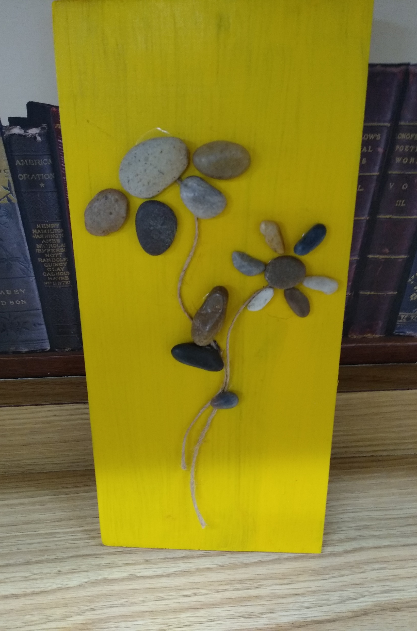
Adult crafts Fisher whiting memorial Library
Social distancing
Crafts with Kim Smith
Time with friends
Evening of fun!
November 10
6:00 PM
FREE
LIMIT 10
REGISTER
November 5
6:00 PM
FREE
LIMIT 10
REGISTER
Metal pumpkins
Rock art on wood
CALL 881-1312 TO REGISTER FOR ONE OR BOTH CRAFTS

